Slide 1


Solving 2D diffusion velocity profile(Navier stokes equation ) and Verlet Integration in SHM using Python
Project work – MM 644 ( ICME )
Submitted by,
Namrata Sarania (2102105016)
Group -1
Under the Guidance of
DR. SUMANTA SAMAL
MEMS DEPARTMENT
INDIAN INSTITUTE OF TECHNOLOGY , INDORE

Slide 2
OUTLINE
Introduction
Objectives
Python library
Problem statement
Problem -1 ( Code & output )
Initial conditions , Boundary conditions , Mathematical formulations etc.
Problem -2 ( Code & output )
Initial conditions , Boundary conditions , Mathematical formulations etc.
References

Slide 3
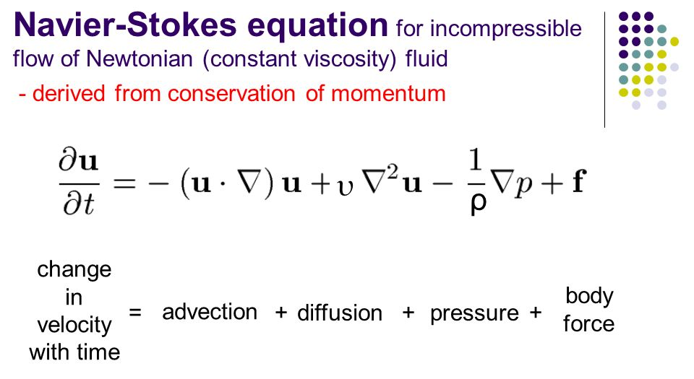
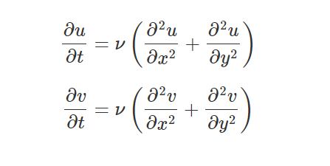
INTRODUCTION
2D second order diffusion ( NS stokes )
Diffusion is a physical process that occurs in a flow of gas in which some property is transported by the random motion of the molecules of the gas.
1
2D diffusion is described as follows :
3
Image source : https://slideplayer.com/slide/9727750/

Slide 4
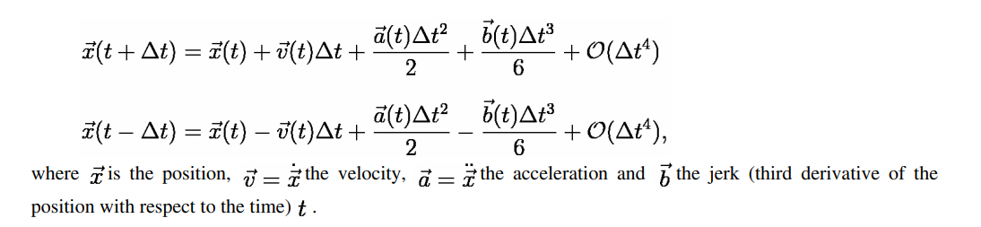
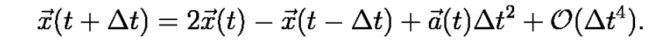
Verlet Integration
Verlet integration is a numerical method used to integrate Newton's equations of motion. It is frequently used to calculate trajectories of particles in molecular dynamics simulations and video games.
2
4
Source :https://resources.saylor.org/wwwresources/archived/site/wp-content/uploads/2011/06/MA221-6.1.pdf

Slide 5
Objectives
Solving 2D second order diffusion (NS equations ) at different time steps using Python and getting the final velocity profile
Comparison of Analytical and Verlet trajectory of a particle in motion ( error analysis after the simulation )

Slide 6
Python libraries - functions
Python Library | Functions
numpy | numpy is a Python library used for working with arrays.
matplotlib | matplotlib is a comprehensive library for creating static, animated, and interactive visualizations in Python.
mpl_toolkits.mplot3d | Generating 3D plots using the mplot3d toolkit.
set_xlim() , set_ylim() | function in axes module of matplotlib library is used to set the x-axis , y-axis view limits.
pyplot | pyplot is a collection of functions that make matplotlib work like MATLAB.

Slide 7
Problem Statement
Problem -1 :Solving 2D second order diffusion (NS equations ) at different time steps using Python
This analysis shows the final velocity profile for 2D diffusion when the initial conditions are a square wave and the boundary conditions are unity.
Input Data (variables ) ,
nx = 31 (number of x spatial points )
ny = 31 (number of y spatial points )
nt = 17 (number of temporal points )
nu = .05
xmax =2 , ymax =2
grid spacing,
dx = 2 / (nx - 1)
dy = 2 / (ny - 1)
sigma = .25
dt = sigma * dx * dy / nu
Variable declarations in Python code part -1

Slide 8
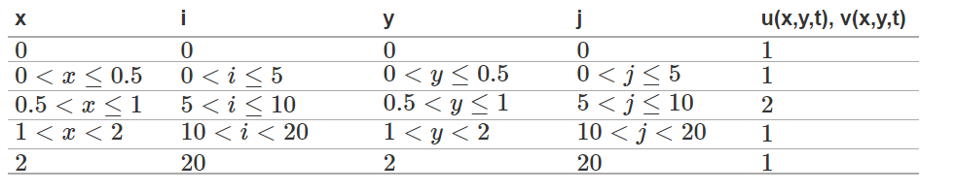
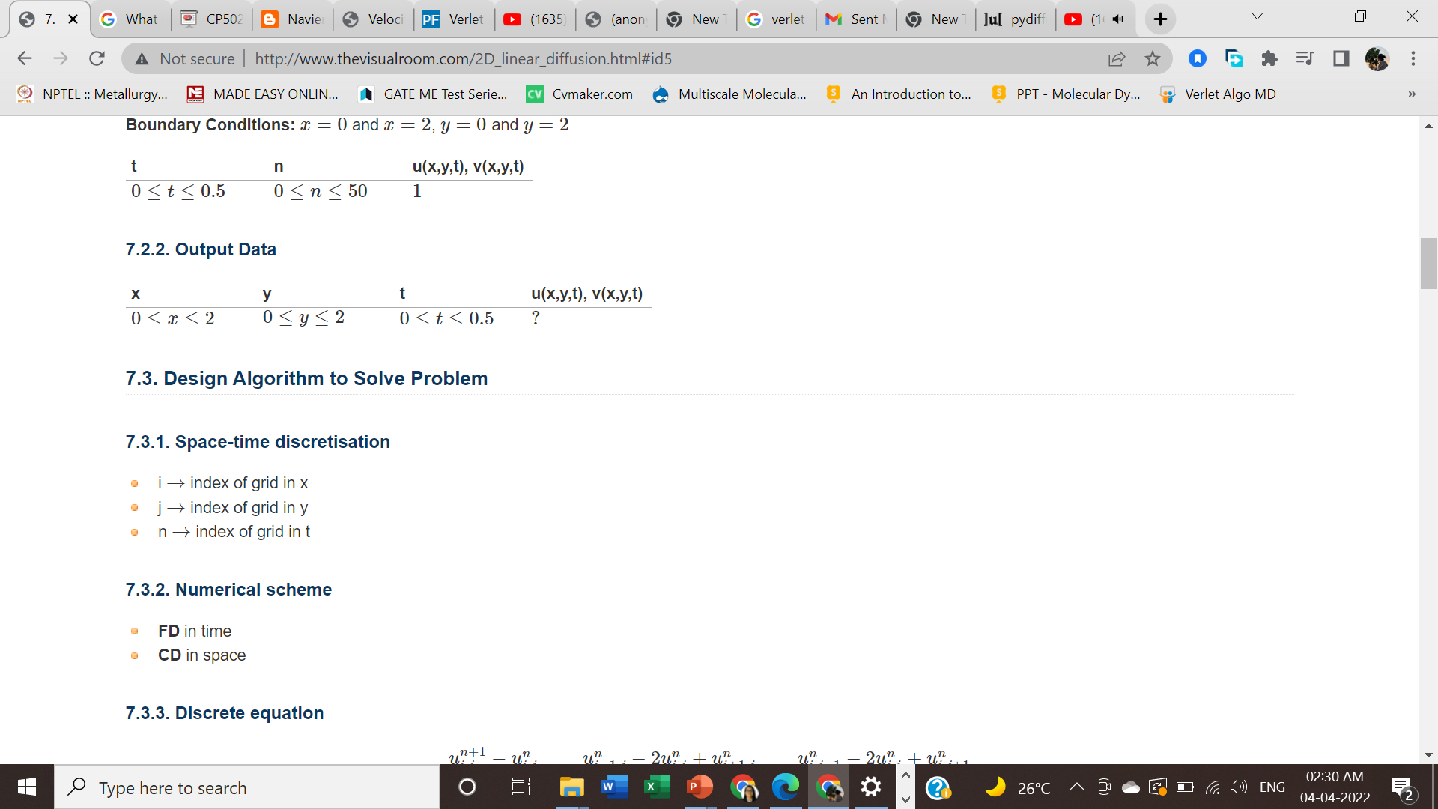
Initial conditions, at t = 0
Boundary conditions
x=0 and x=2, y=0 and y=2
u[0,:,:] = u[nx-1,:,:] = u[:,0,:] = u[:,ny-1,:] = 1
v[0,:,:] = v[nx-1,:,:] = v[:,0,:] = v[:,ny-1,:] = 1
Design algorithm to solve the problem
(a) Space – time discretization (b) Numerical scheme

Slide 9
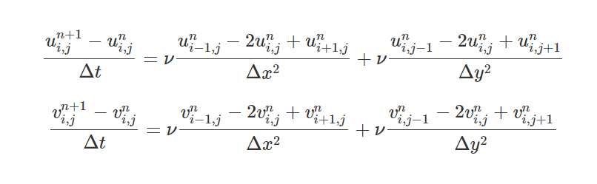
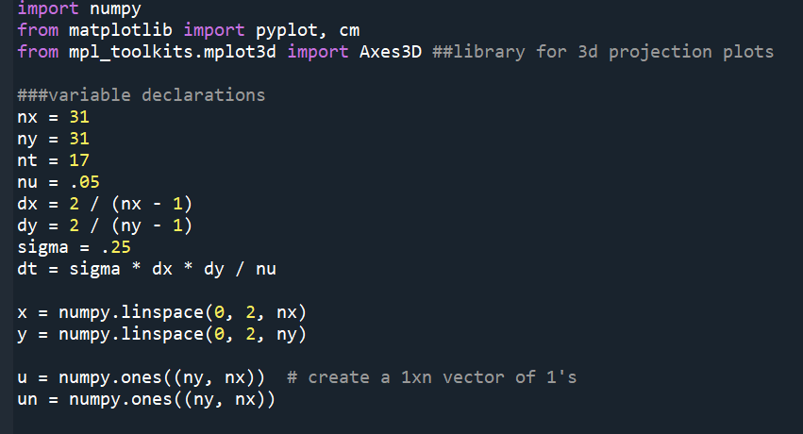
(c) Discrete equation
Python Code :

Slide 10
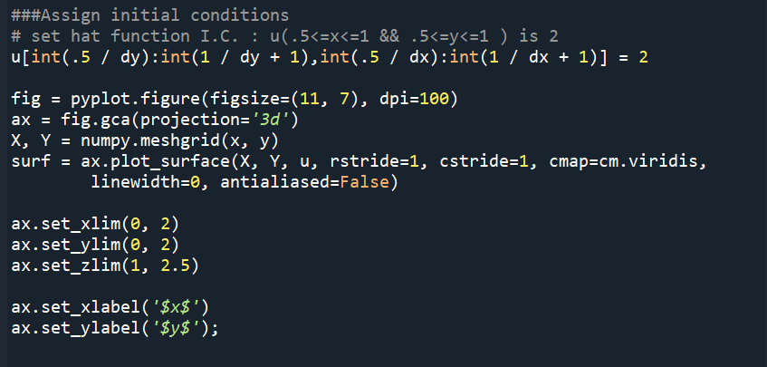
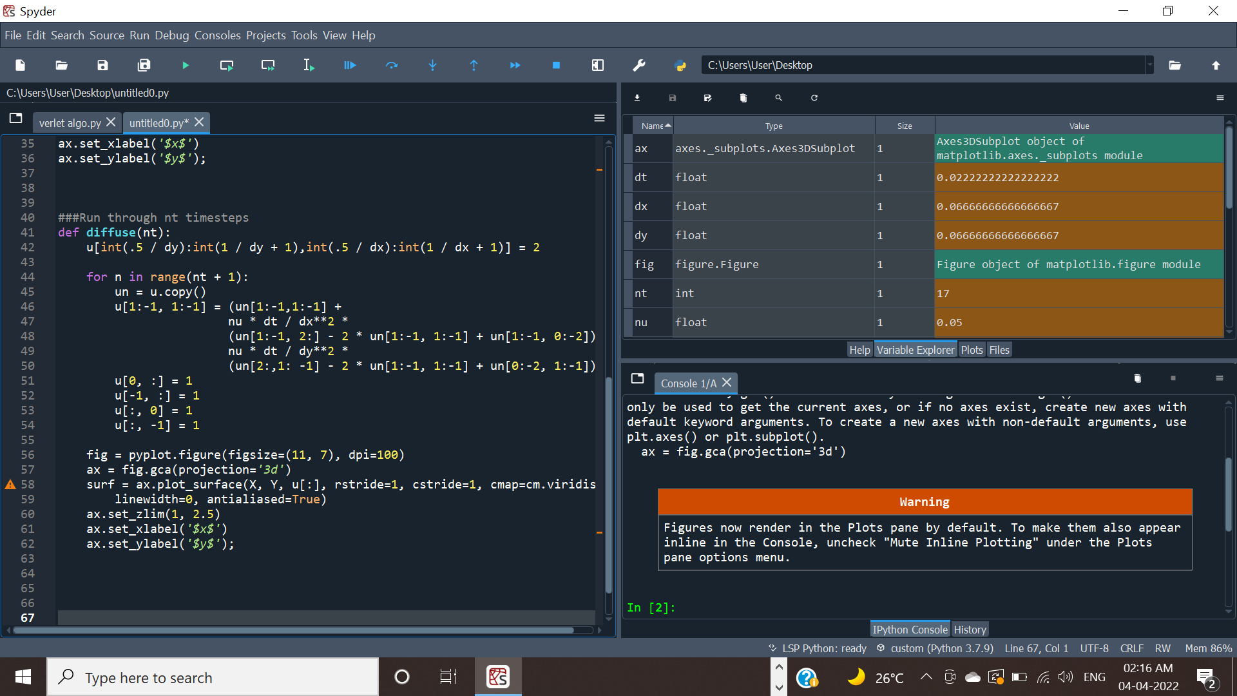

Slide 11
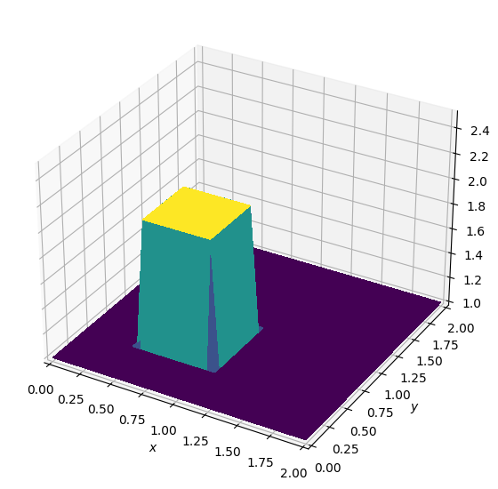
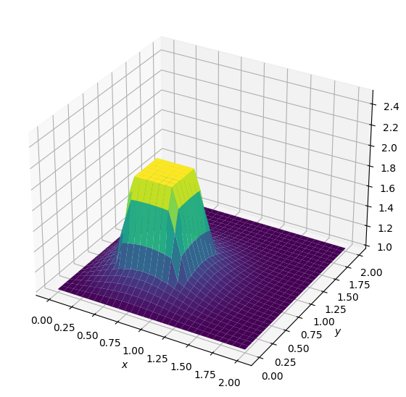
Output :
Fig 1. -Initial runfile
Fig 2. -diffusion at zero time steps

Slide 12
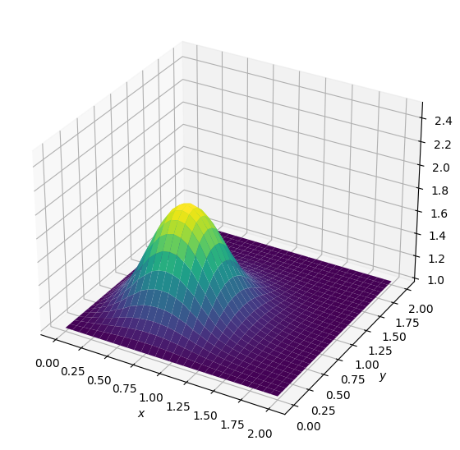
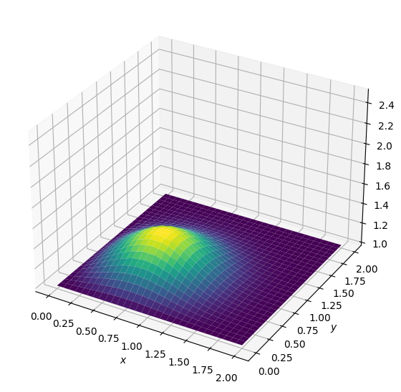
Output :
Fig 3. -diffusion at time steps =10
Fig 4. -diffusion at time steps =50

Slide 13
Problem -2 :Verlet integration method to plot trajectories of SHM
Trajectory of a simple harmonic oscillator example is used in this present work.
Comparing the analytical solution and verlet integration solution trajectories , and then performing some error analysis by changing the accuracy .
Constants used ,
Spring constant , k =1
Mass of the particle , m =1
Time step or accuracy , dt = 0.1
Simulation time , tm = 10
Initial conditions
x =[ 1]
v = [0]
time ,t =0
x and v are the initial position and velocity, respectively.

Slide 14
Verlet Algorithm
Acceleration
a = -(k/m) *x[i]
Using Euler cromer method for initialization ,
Velocity , v_next =v[i]+a*dt
Position ,x_next =x[i] +v_next*dt
Next step , using Verlet
Position, x_next =2*x[i] –x[i-1] + a*dt**2
Position update , x.append (x_next)
Time update , t.append(t[i]+dt )
Analytical solution ,
omg=(k/m)**0.5
xa= x[0]*cos(omg*array(t))

Slide 15
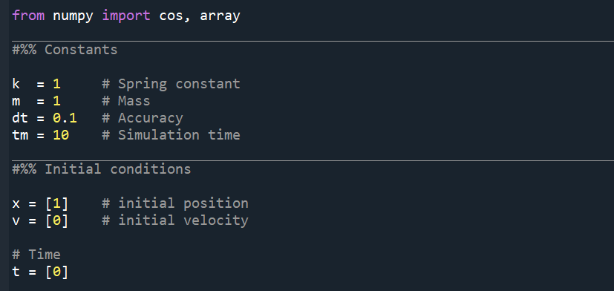
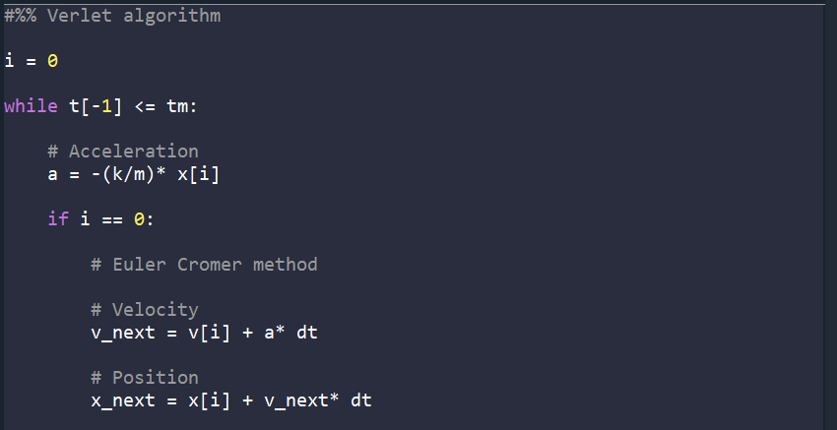
Python Code

Slide 16

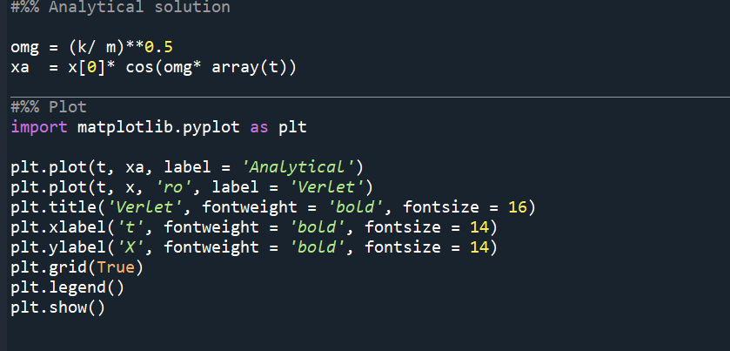

Slide 17
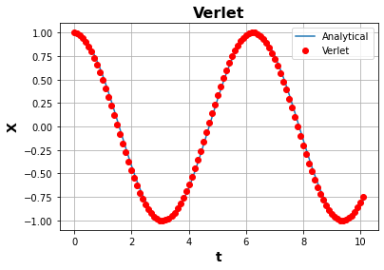
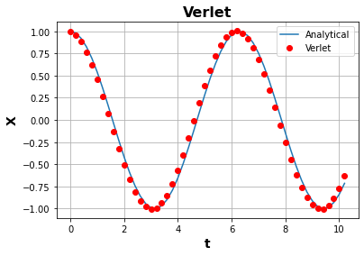
Output
Fig 5. -Trajectory at dt =0.1
Fig 6. -Trajectory at dt =0.2

Slide 18
References
Dr. Sumanta Samal class notes ( MM 644 / Lec -15 )
Dr. Sumanta Samal class notes ( MM 644 / Lec -10 )
http://www.thevisualroom.com/2D_linear_diffusion.html
https://slideplayer.com/slide/5310307/
https://resources.saylor.org/wwwresources/archived/site/wp-content/uploads/2011/06/MA221-6.1.pdf

Slide 19
Thank You

